Slide 1
Airline Passenger Satisfaction
Mudit Aggrawal , Hong Fei Jin , Jenny Yao , Pedro Jose Trujillo Mejia​, Himanshu Mayank ​, Nilanjana Raghu ​, Ying Fang Liang

Slide 2
Our Team
Business Analysts:
Hong Fei Jin – jinh1004
Pedro Trujillo – PedroJoseTrujilloMejia
Data Scientist:
Himanshu Mayank – hm6650
Data Engineer:
Mudit Aggarwal Muditmoody
Ying-Fang Liang yingfangliang
Nilanjana R Raghu – Nilanjana-Raghu
Jenny Yao – Jiaying-Yao

Slide 3
Introduction

Slide 4

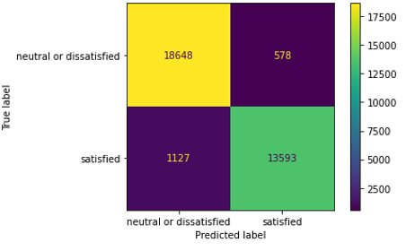
Review
What factors affect customer satisfaction the most in the context of airline passengers?
103,904 Observations from an airline passenger satisfaction survey
23 Variables including Satisfaction, Flight distance, Type of Travel
XGBoost Classification Model with an accuracy of 96% using the best parameters

Slide 5
Docker Stuff?
PLACEHOLDER FOR UCs

Slide 6
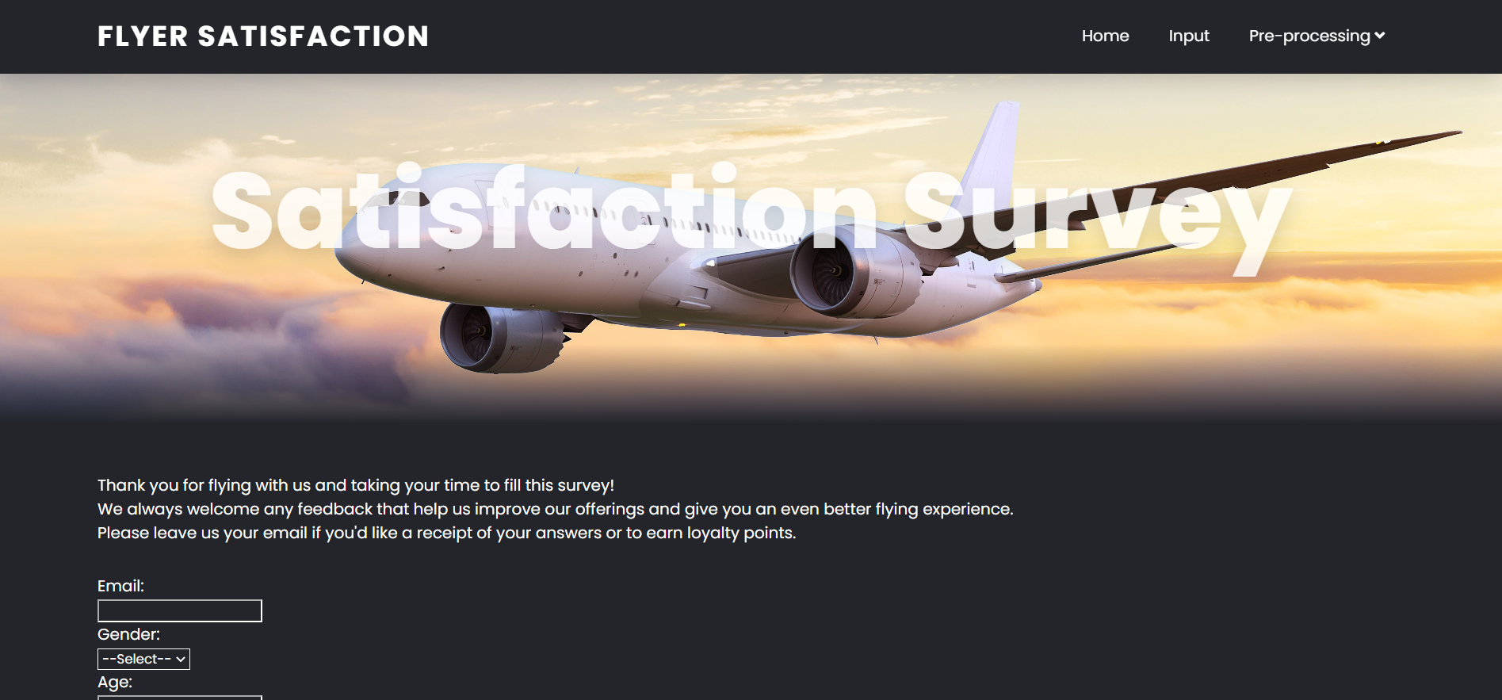
User Interface

Slide 7
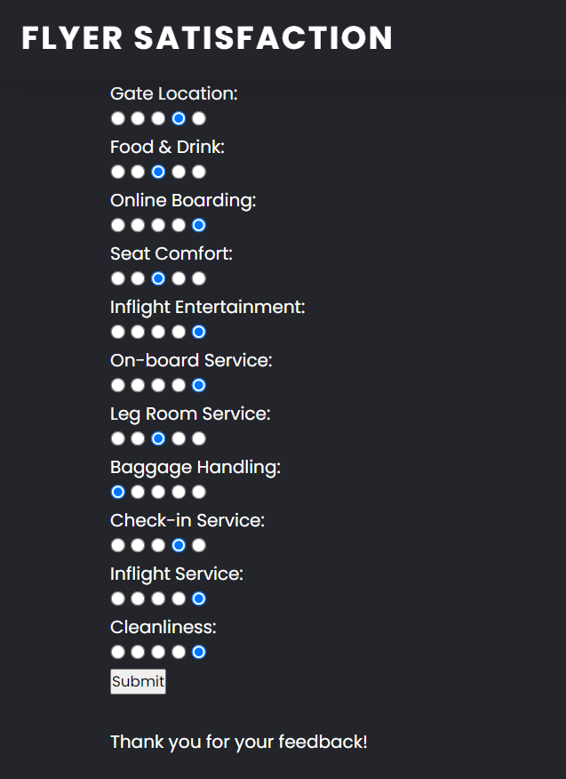
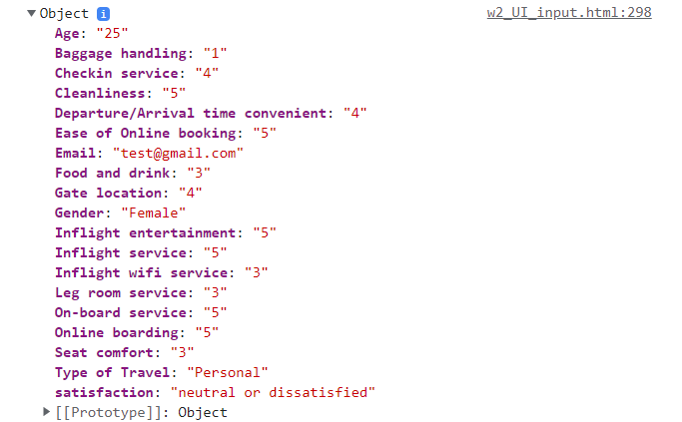
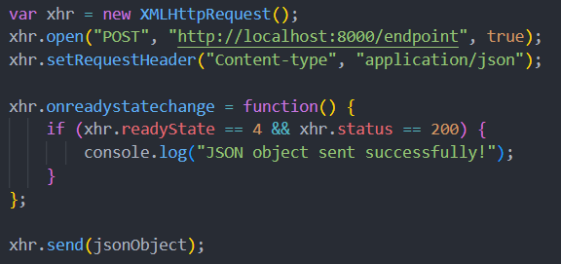
User Interface

Slide 8
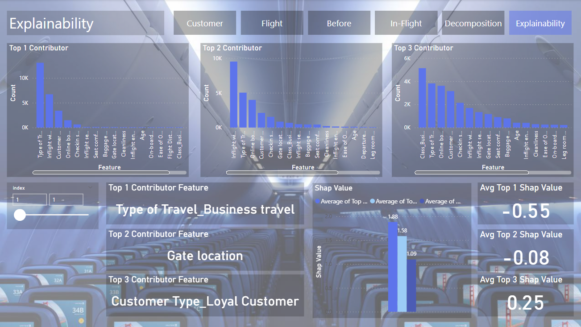
User Interface

Slide 9
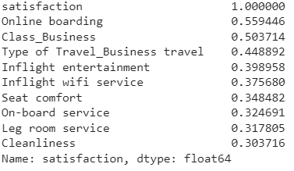
Target Leakage
Occurs when predictors include data that is not available at the time of making the prediction (after the flight in our context)
“Online boarding”, “Inflight Wifi Service”, “Baggage Handling”
might be leaky predictors
With
Without
95.3%
92.8%
CV Accuracy
CV Accuracy
These predictors are not greatly influencing model accuracy

Slide 10
Fairness and Ethics of Model
Variables:
Age - Young age 'Age' <= 25, Middle aged 'Age' > 25 , Old Age, 'Age'> 50
Gender – Male and Female
Metrics:
Demographic Parity - is a principle that requires that the model's predictions should not systematically favor or disfavor any demographic group.
True Positive Rate - It measures the proportion of positive instances (i.e., instances belonging to the positive class) that are correctly identified by the model as positive.
False Positive Rate - tells us how often the model makes a positive prediction when the true label is negative.
Metric | Age | Gender
Demographic Parity | Young: 0.25, Middle-aged: 0.47, Old: 0.45 | Female: 0.41, Male: 0.43
True Positive Rate | Young: 0.85, Middle-aged: 0.94, Old: 0.93 | Female : 0.925, Male : 0.932
False Positive Rate | Young : 0.00, Middle-aged : 0.00, Old: 0.00 | Female: 0.00 Male: 0.00

Slide 11
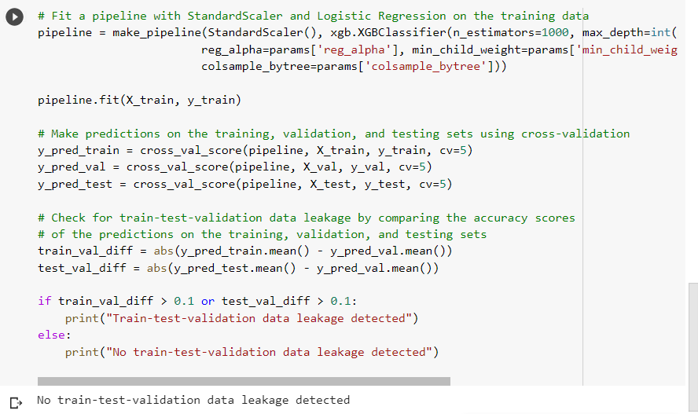
Train-Test Leakage
When data from validation / test sets are inadvertently used in training the model, leading to overly optimistic performance estimates & poor generalization performance
Code trains an XGBoost classification model (had the best accuracy amongst tested models)
Then uses cross-validation to make predictions on training, validation, and testing sets
Pipeline trained & validated without any evidence of data leakage

Slide 12
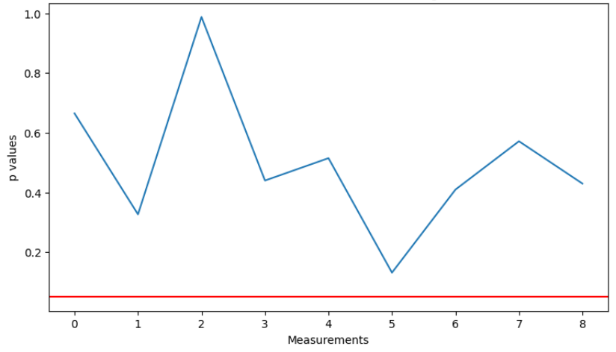
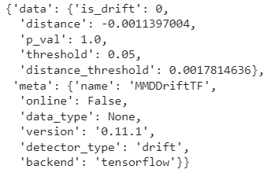
Data Drift
Check the quality of incoming data with respect to existing data
Samples of data are used to monitor changes in data distribution
Approaches:
Statistical Methods – Kolmogorov-Smirnov (K-S) Test (Null values, outliers, data dist)
ML Models – TensorFlow Keras layers, ClassifierDrift
Statistical Control of Outliers in Flight Distance
One method to solve the issue would be by increasing the weight of more recent points
Data does not have any drift

Slide 13
AutoML & Optimization

Slide 14
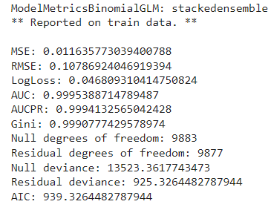
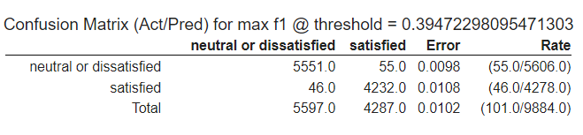
AutoML: H2O
Automated model selection, tuning, and deployment for highly accurate predictive models
Time-saving workflow by automating time-consuming tasks, such as feature engineering and hyperparameter tuning
Intuitive interface for ease of use
Advanced algorithms that ensure accuracy and reliability, even with complex datasets
Open-source and free to use
Models with top 3 accuracy:
Stacked Ensemble
Gradient Boosting Machine
XGBoost
error = h2o_compare['actual'] - h2o_compare['predicted']

Slide 15
AutoML: TPOT
Optimize ML pipeline using genetic programming
Can automate ML processes including feature selection, feature construction, model selection, parameter optimization and so on
We tried TPOT both on the original dataset with dummy-fied variables (to observe its feature manipulation capability) as well as on the fully prepared dataset (to see how it perform model selection and parameter tuning)
There is a chance that TPOT use imputer for fully processed data, however, TPOT always deploys a simple imputer for unprocessed input data
Best Ensembled Model on Fully Processed Dataset:
Imputer: Median
Estimator 1: BernoulliNB
Estimator 2: XGBClassifier
Estimator 3: BernoulliNB
Final Estimator: MLPClassifier
Validation Score: 95.93
Best Model on Original Dataset:
Imputer: Median
Model: ExtraTreesClassifier
Validation Score: 96.20

Slide 16
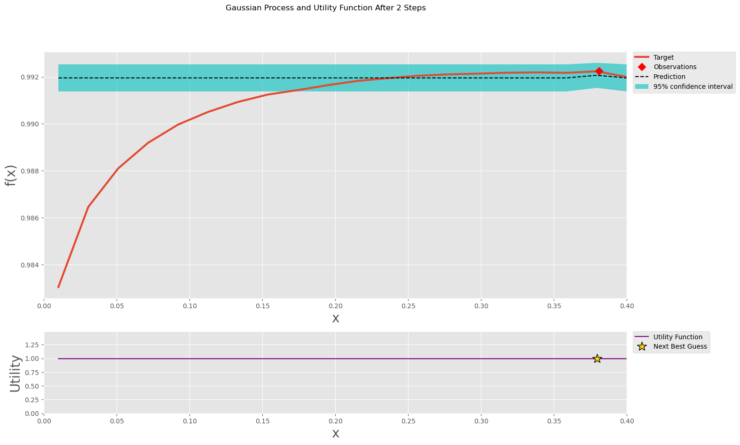
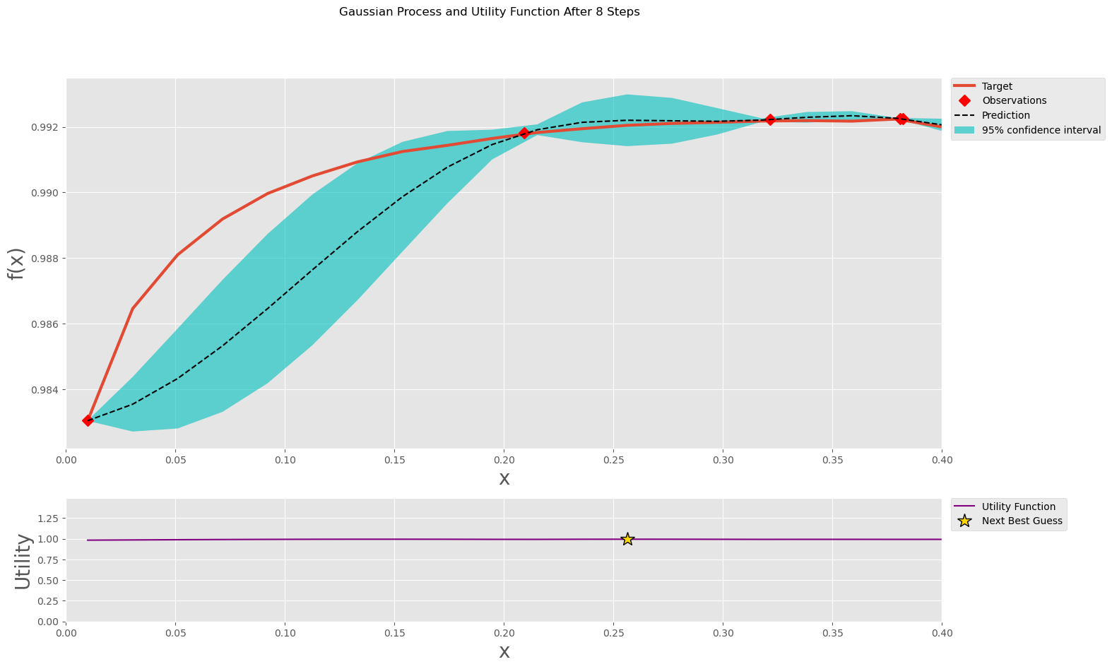
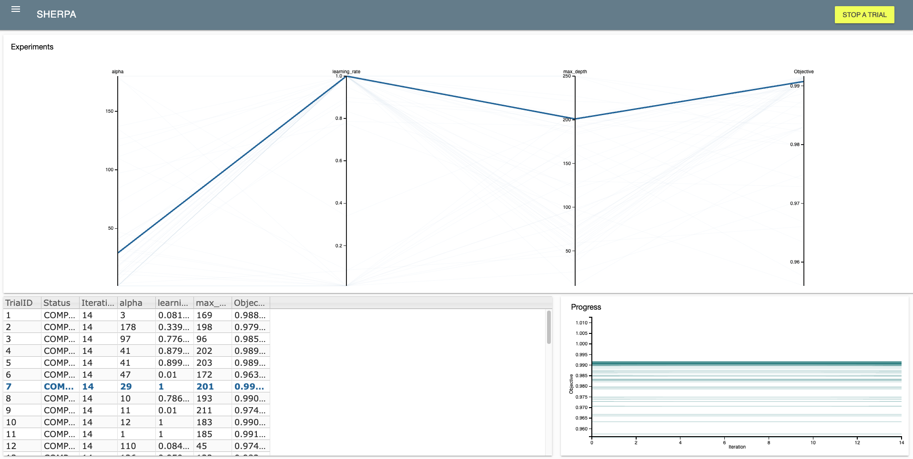
Hyperparameter Optimization
bayes_opt: Set parameter bounds, define the target function (cross-validation values), and run optimization with .maximize()
SHERPA: Library that provides various hyperparameter tuning algorithms including Bayesian, Asynchronous Successive Halving (ASHA), and Population-based methods. We can also define parameter types

Slide 17
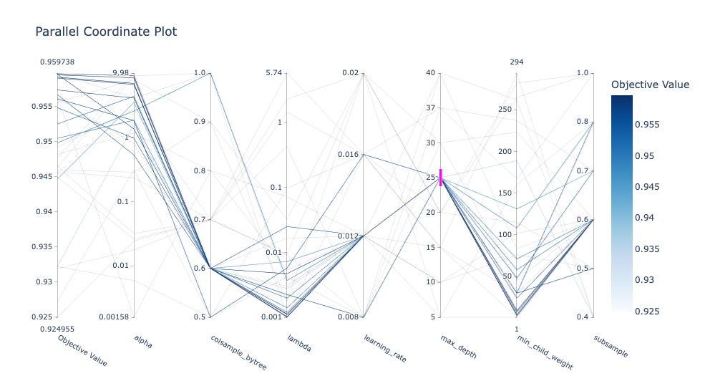
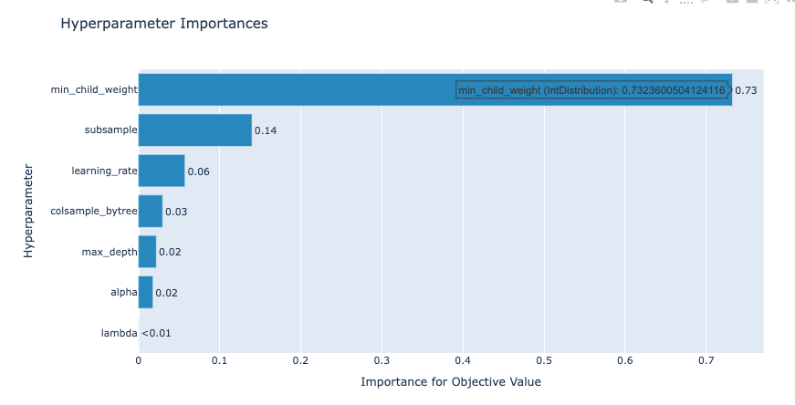
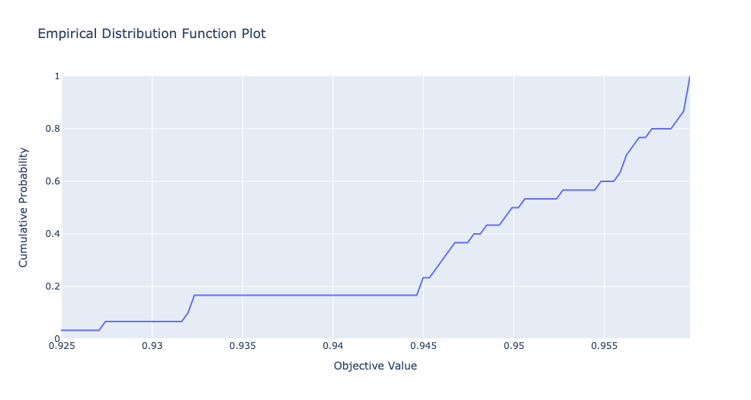
Hyperparameter Optimization
Optuna: Allows users to define the preferred range of hyperparameter & target objective before trying combinations of hyperparameters
One optimization process is called a “study”
HyperOpt: Instead of defining the search space in the objective function, HyperOpt allows us to define it using hp.choice outside of the objective function
Interactive plots produced using the visualization function in Optuna

Slide 18
Optimization Summary
 | Learning Rate | Alpha | Max Depth | Accuracy of Validation Set
Bayesian Optimization | 0.462 | 1 | 23 | 0.9597
ASHA by SHERPA | 0.773 | 24 | 127 | 0.9609
Optuna | 0.016 | 4.069 | 15 | 0.9511
HyperOpt | 0.368 | 2.147 | 10 | 0.9591

Slide 19
Explainability

Slide 20
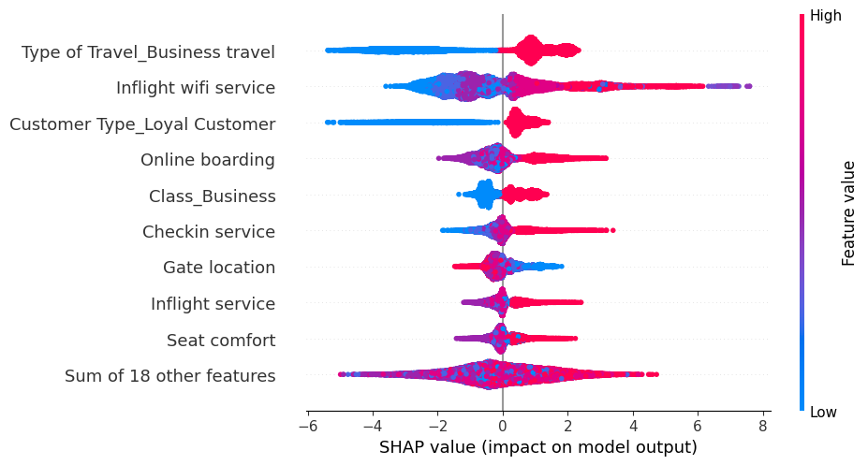
Model Explainability Using SHAP
Using SHAP values to decompose the prediction into contributions from each input feature, we can gain insight into how the model is making its decisions
Business class travel increases the probability of a customer being satisfied
For loyal customers, the probability of the customer being satisfied is higher
For online boarding, business class and check-in service, the probability of a customer being satisfied is higher
For higher values of inflight service and seat comfort, the probability of a customer being satisfied is higher

Slide 21
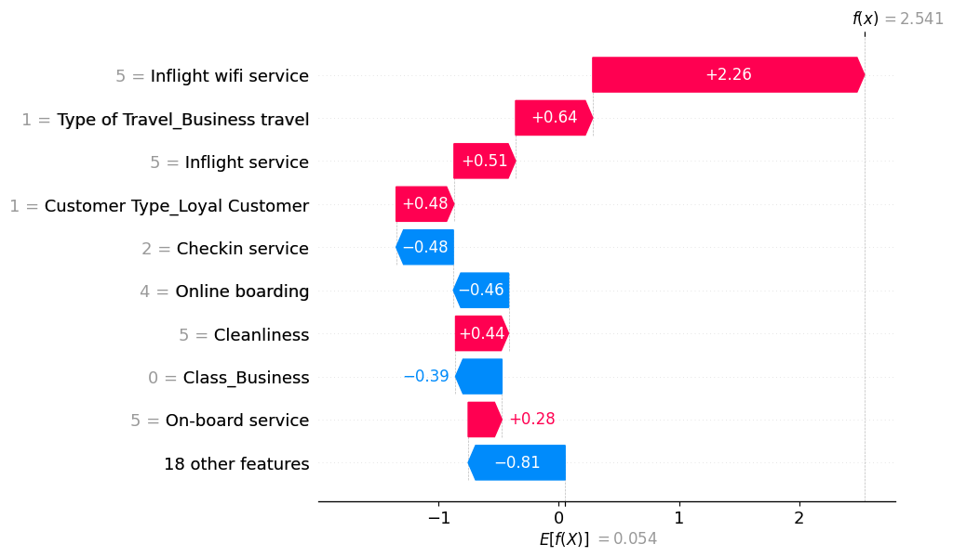
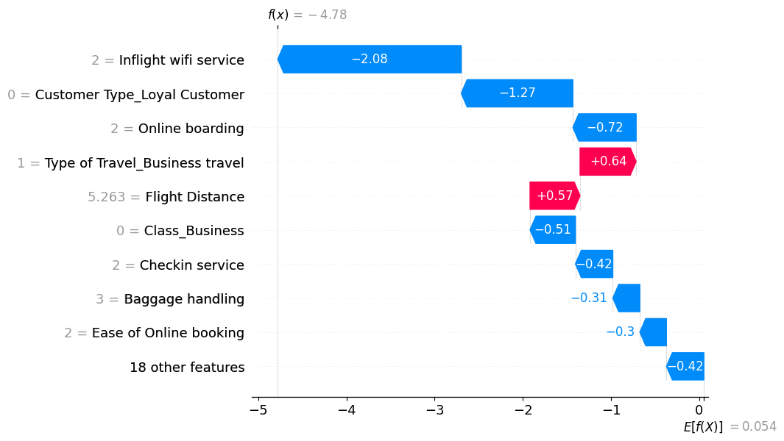
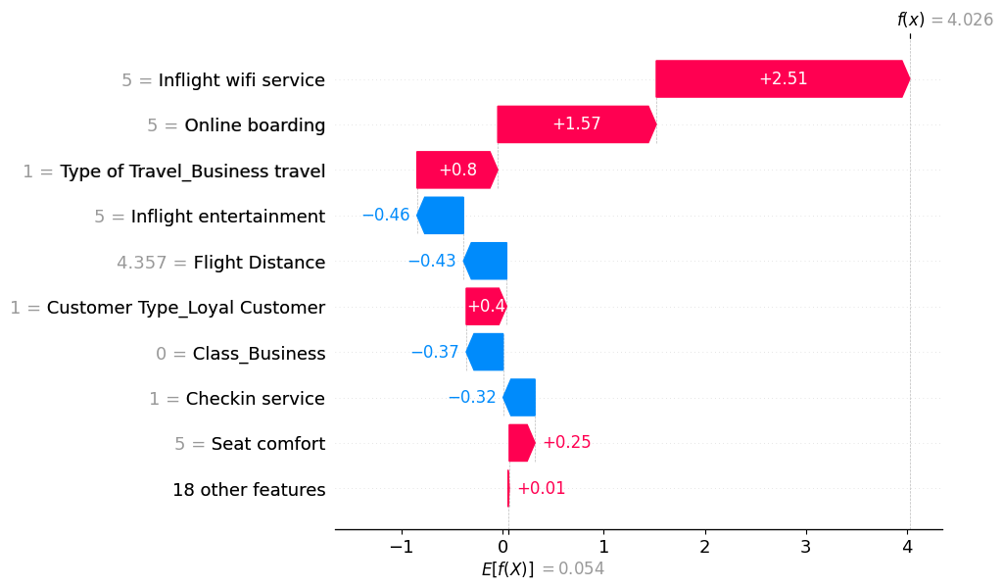
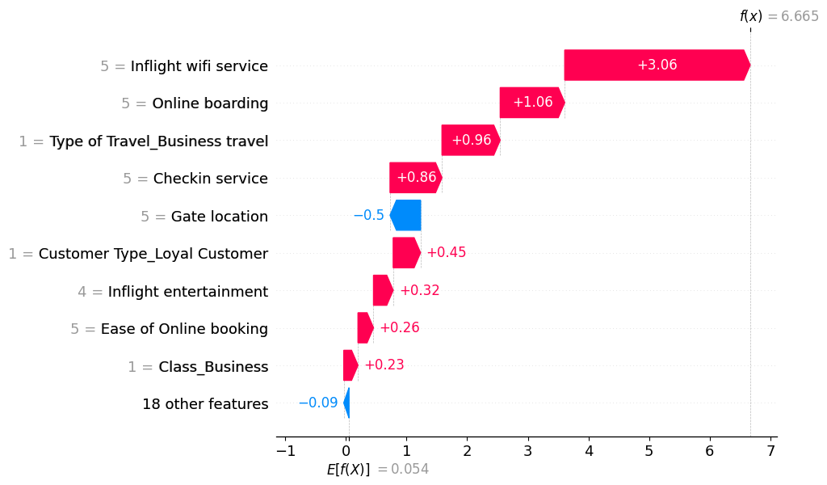
Model Explainability

Slide 22
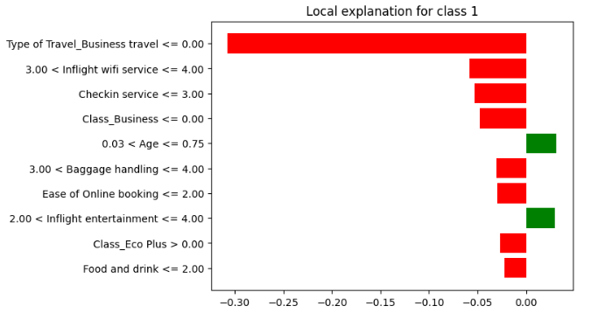
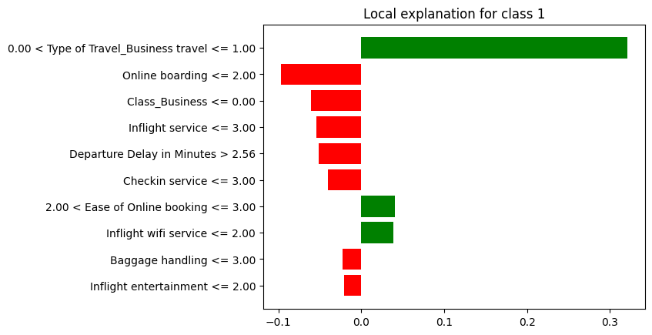
Comparison with LIME

Slide 23
Overview of Fairness & Ethics
As AI becomes more integrated into our daily lives, it has the potential to impact a wide range of social, economic, and political issues, such as privacy, security, employment, and justice.
Bias & Discrimination: AI systems can perpetuate and amplify biases & discrimination if they are not designed and trained with fairness in mind. The result is unfair outcomes for individuals or groups based on their race, gender, religion, or other characteristics
Transparency & Explainability: You should be able to explain how the AI arrive at a decisions, what data it utilized, and what assumptions were made
Privacy & Security: AI systems should comply with relevant data protection & security standards
Governance & Accountability: Clear lines of responsibility and accountability for the development, deployment, and use of AI systems, and the effective mechanisms for monitoring and enforcing ethical and legal standards should be drawn
Identify sensitive features in the dataset
Analyze dataset for potential bias

Slide 24
Overview of Fairness & Ethics
Sensitive Information - Personal Identifiable Information (PII) : In the case of our dataset, there are no PIIs, but potential PII that may leak could include Credit card information, home addresses, cell phone numbers, etc.
Result: Organizations found to be in violation of data privacy laws / regulations can face legal penalties and fines. Their reputation can be also be damaged as people lose trust in the organization
Example code of possible approach to evaluate data leakage:

Slide 25
Fairness & Ethics In Our Project
Respondents of the dataset heavily centered in the 18-50 age group with 66%. 25% of the respondents are 50+ and the remaining are under 18
Implication: If the model identified Age as an important feature and an airline makes recommendation on this basis, it could lead to age discrimination, e.g. older passengers may value seat assignment the most, but the model may not capture that
Solution: Data augmentation or creation of synthetic data for underrepresented age groups

Slide 26
Thank you!
Any questions?

Slide 27
Appendix

Slide 28
Project Links
Git Project - https://github.com/orgs/McGill-MMA-EnterpriseAnalytics/projects/29
Git Repository - https://github.com/McGill-MMA-EnterpriseAnalytics/Flyer_Customer_Satisfaction

